Slide 1
14
Firms in Competitive Markets

Slide 2

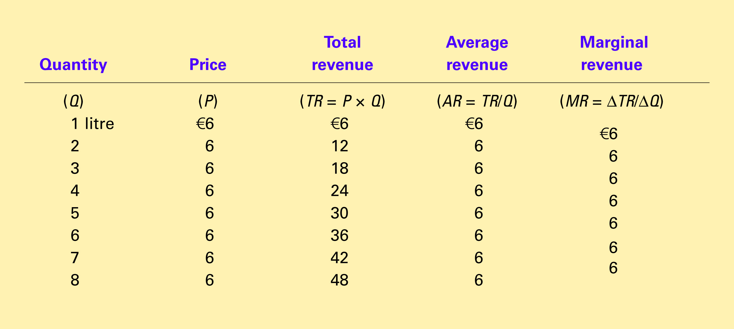
Table 1 Total, Average, and Marginal Revenue for a Competitive Firm
Copyright©2004 South-Western

Slide 3
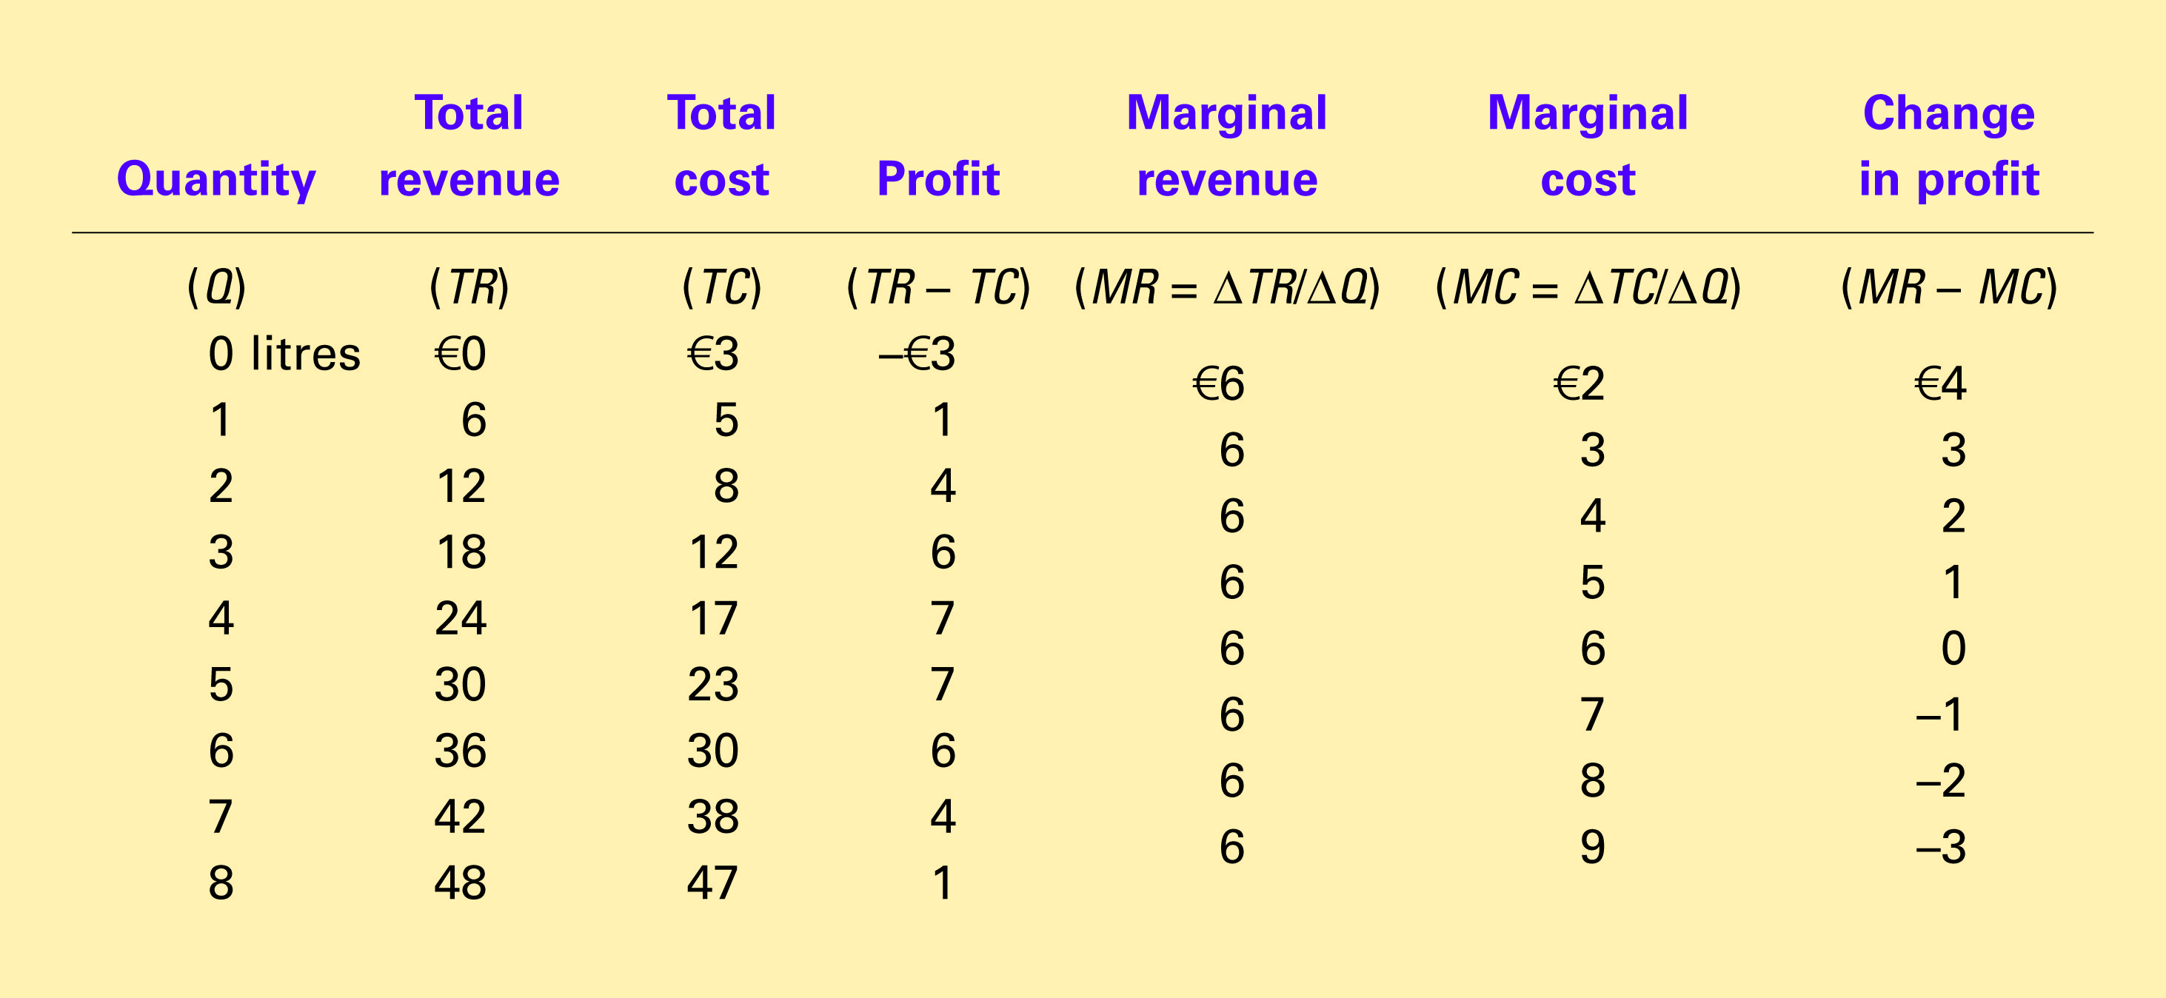
Table 2 Profit Maximization: A Numerical Example
Copyright©2004 South-Western

Slide 4

Figure 1 Profit Maximization for a Competitive Firm
Costs
and
The firm maximizes
Revenue
profit by producing
the quantity at which
marginal cost equals
MC
marginal revenue.
MC
2
ATC
P
=
MR
1
=
MR
2
P
=
AR
=
MR
AVC
MC
1
0
Q
1
Q
MAX
Q
2
Quantity
Copyright © 2004 South-Western

Slide 5
Figure 2 Marginal Cost as the Competitive Firm’s Supply Curve
Price
This section of the
firm’s MC curve is
also the firm’s supply
curve.
MC
P
2
ATC
P
1
AVC
0
Q
1
Q
2
Quantity
Copyright © 2004 South-Western

Slide 6
Figure 3 The Competitive Firm’s Short Run Supply Curve
Costs
Firm
’
s short-run
If P > ATC, the firm will continue to produce at a profit.
supply curve
MC
ATC
If P > AVC, firm will continue to produce in the short run.
AVC
Firm
shuts
down if
P
<
AVC
0
Quantity
Copyright © 2004 South-Western

Slide 7
Figure 4 The Competitive Firm’s Long-Run Supply Curve
Costs
Firm
’
s long-run
supply curve
MC = long-run S
Firm
enters if
P > ATC
ATC
Firm
exits if
P < ATC
0
Quantity
Copyright © 2004 South-Western

Slide 8
Figure 4 The Competitive Firm’s Long-Run Supply Curve
Costs
MC
Firm
’
s long-run
supply curve
ATC
0
Quantity
Copyright © 2004 South-Western

Slide 9
Figure 5 Profit as the Area between Price and Average Total Cost
(a) A Firm with Profits
Price
MC
ATC
Profit
P
ATC
P
=
AR
=
MR
0
Q
Quantity
(profit-maximizing quantity)
Copyright © 2004 South-Western

Slide 10
Figure 5 Profit as the Area between Price and Average Total Cost
(b) A Firm with Losses
Price
MC
ATC
ATC
P
P
=
AR
=
MR
Loss
0
Q
Quantity
(loss-minimizing quantity)
Copyright © 2004 South-Western

Slide 11
Figure 6 Market Supply with a Fixed Number of Firms
(a) Individual Firm Supply
(b) Market Supply
Price
Price
MC
Supply
€ 2.00
€ 2.00
1.00
1.00
0
100
200
Quantity (firm)
0
100,000
200,000
Quantity (market)
Copyright © 2004 South-Western

Slide 12
Figure 7 Market Supply with Entry and Exit
(a) Firm
’
s Zero-Profit Condition
(b) Market Supply
Price
Price
MC
ATC
P
= minimum
Supply
ATC
0
Quantity (firm)
0
Quantity (market)
Copyright © 2004 South-Western

Slide 13
Figure 8 An Increase in Demand in the Short Run and Long Run
(a) Initial Condition
Firm
Market
Price
Price
MC
ATC
Short-run supply,
S
1
A
P
1
P
1
Long-run
supply
Demand,
D
1
0
Quantity (firm)
0
Q
1
Quantity (market)

Slide 14
Figure 8 An Increase in Demand in the Short Run and Long Run
(b) Short-Run Response
Firm
Market
Price
Price
Profit
MC
ATC
S
1
P
P
B
2
2
A
P
1
P
1
Long-run
supply
D
2
D
1
0
Quantity (firm)
0
Q
1
Q
2
Quantity (market)
Copyright © 2004 South-Western

Slide 15
Figure 8 An Increase in Demand in the Short Run and Long Run
(c) Long-Run Response
Firm
Market
Price
Price
MC
ATC
S
1
P
B
S
2
2
A
C
P
1
P
1
Long-run
supply
D
2
D
1
0
Quantity (firm)
0
Q
1
Q
2
Q
3
Quantity (market)
Copyright © 2004 South-Western

